Slide 1
Physics-Informed Reconstruction of Cylinder Flow with Reynolds Continuation
PINN-based reconstruction and transition analysis for 2D incompressible flow past a cylinder
Junhe Chen
Spring 2026

Slide 3
Project Overview
Physical problem, objectives, and expected transition behavior
Problem Statement
Main Deliverables
2D incompressible flow past a circular cylinder is a canonical benchmark in fluid dynamics.
As Reynolds number increases, the wake evolves from steady symmetric recirculation to time-periodic vortex shedding.
This project uses a Physics-Informed Neural Network (PINN) to reconstruct the flow field and study the transition region.
Flow reconstruction
Velocity, pressure, vorticity, and streamlines
Reusable pipeline
Continuation training across Reynolds numbers
Geometry and setup
Cylinder radius R = 0.5
Domain x in [-5, 25], y in [-10, 10]
Target Reynolds sweep: Re = 5 to 100

Slide 4
Governing Equations and PINN Formulation
2D incompressible Navier-Stokes with stream-function parameterization
Navier-Stokes Equations
Stream Function Form
u_t + u u_x + v u_y = -p_x + (1/Re)(u_xx + u_yy)
v_t + u v_x + v v_y = -p_y + (1/Re)(v_xx + v_yy)
u_x + v_y = 0
Represent the solution as
psi(x, y, t), p(x, y, t)
u = d psi / d y
v = - d psi / d x
The PINN minimizes PDE residuals together with boundary, initial, and outlet constraints using automatic differentiation.
Enforces incompressibility by construction.
Removes the need for an extra divergence penalty term.
Produces smooth derivatives compatible with PDE residual evaluation.

Slide 5
Network Architecture, Training, and Loss Design
Model Architecture
Loss Function
Sampling Strategy
(x, y, t) --> MLP --> (psi, p)
L = L_pde + 10 L_bc + 10 L_ic + L_out
Physics-aware collocation
Width
128 neurons/layer
PDE loss: momentum residuals from Navier-Stokes.
Boundary loss: inlet, wall, and far-field conditions.
Initial loss: uniform initialization in the domain.
Outlet loss: pressure / gradient regularization downstream.
50%
30%
20%
Depth
6 hidden layers
Refine points near the cylinder to capture boundary-layer behavior.
Bias sampling in the wake to resolve separation and shedding.
Use smoother activation and derivatives for stable AD-based training.
Activation
tanh
Optimizer
Adam + L-BFGS

Slide 6
Reynolds Continuation Strategy
Warm-starting across Reynolds numbers to improve optimization stability
Continuation Workflow
Re = 5
Re = 40
Re = 40-60
Re = 61-100
Initialize low-Re steady solution
Transfer weights and continue training
Resolve transition region carefully
Track increasingly unsteady wake dynamics
More stable optimization
Fewer iterations at each new Re
Better continuity across the parameter sweep

Slide 7
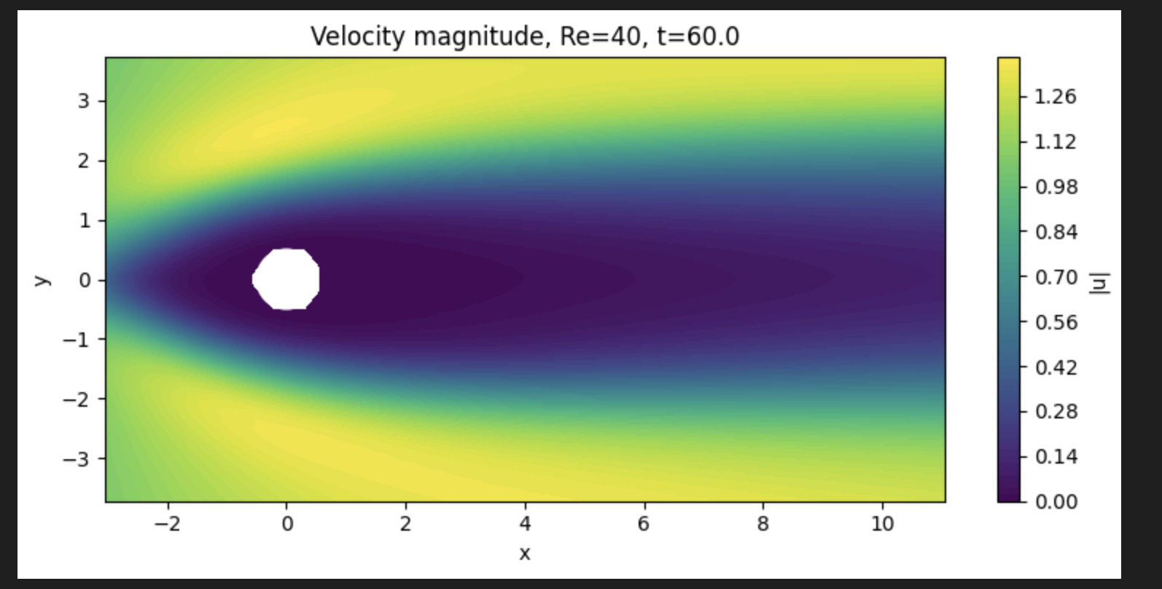
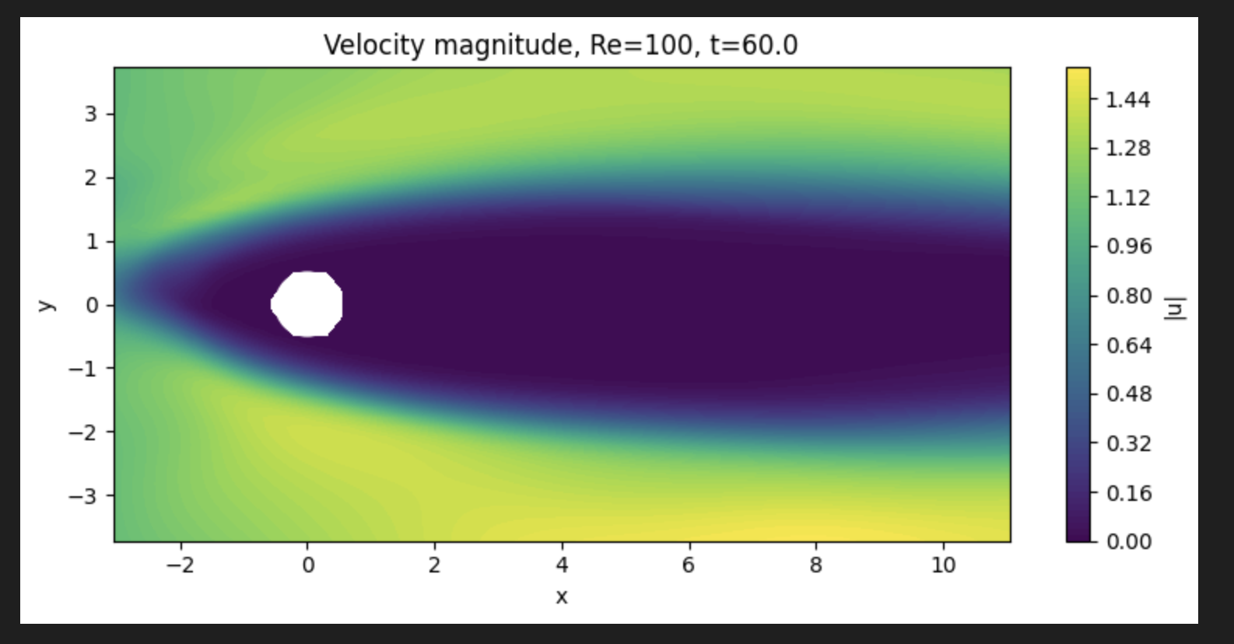
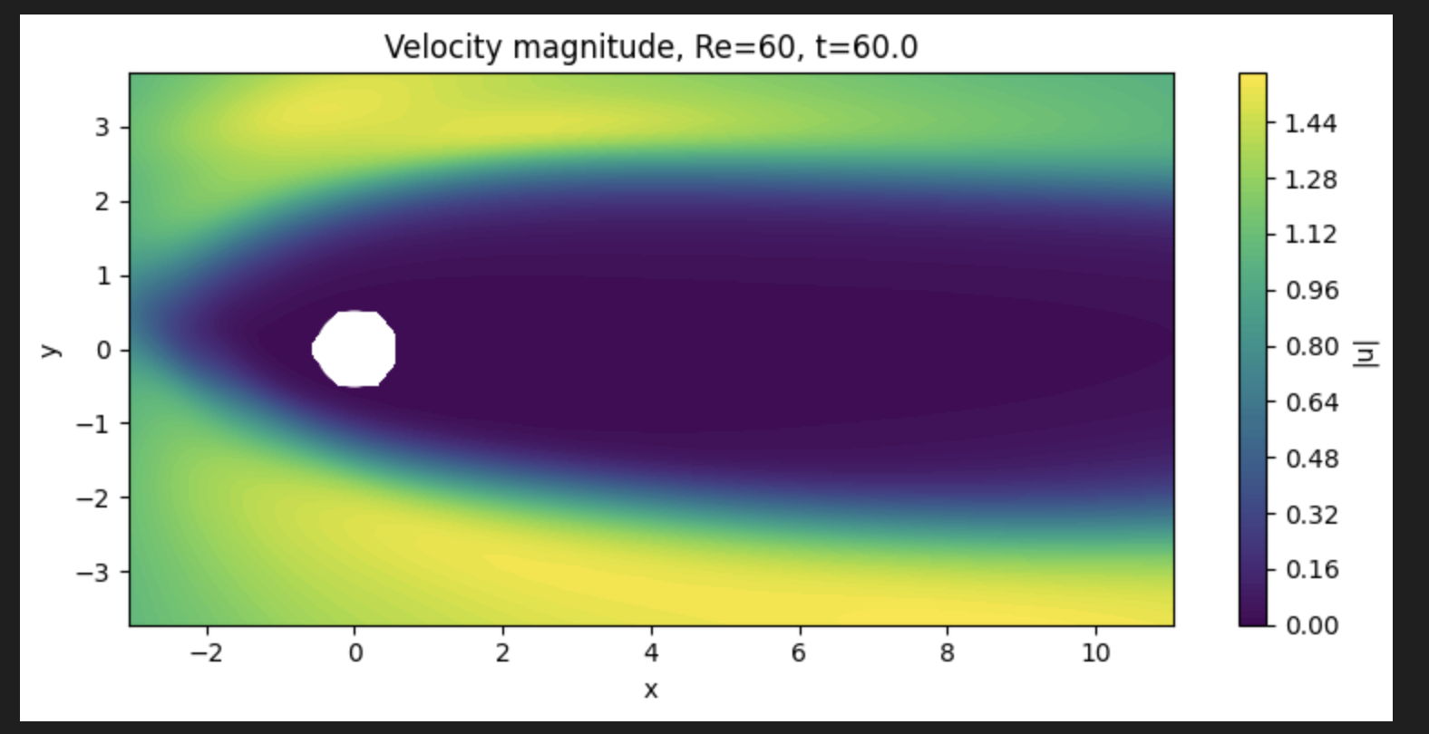
Results Placeholder: Flow Reconstruction
Replace placeholder panels with your exported figures
Key observations
Velocity magnitude should show stagnation at the front face and acceleration near the cylinder sides.
Downstream recovery and recirculation bubble length can be compared across Reynolds numbers.
Use the same colorbar range when comparing multiple Re values.
Recommended figures
• Velocity magnitude contour at representative times
• Streamline plot showing wake topology
• Optional comparison: Re = 40, 60, 100

Slide 10
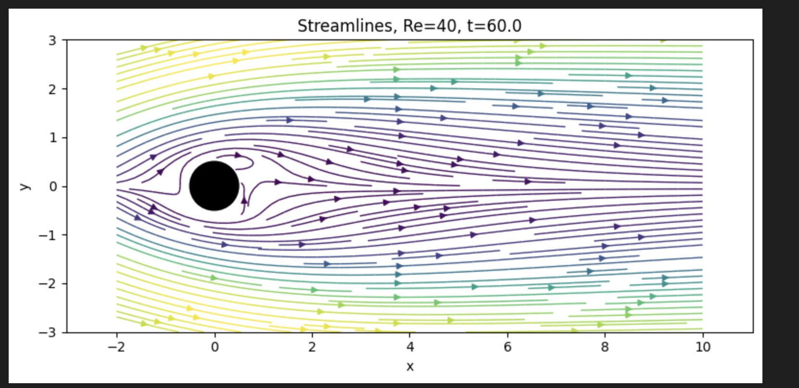

Slide 11
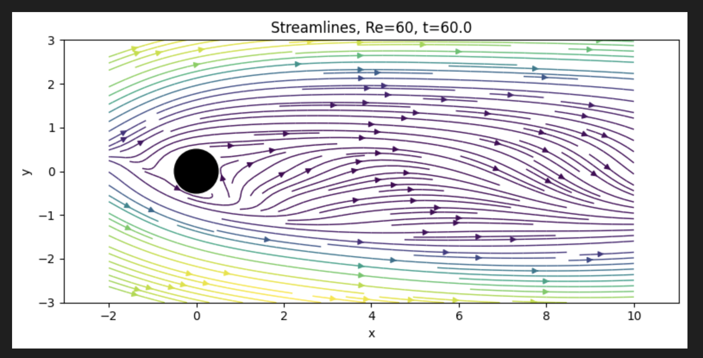

Slide 12
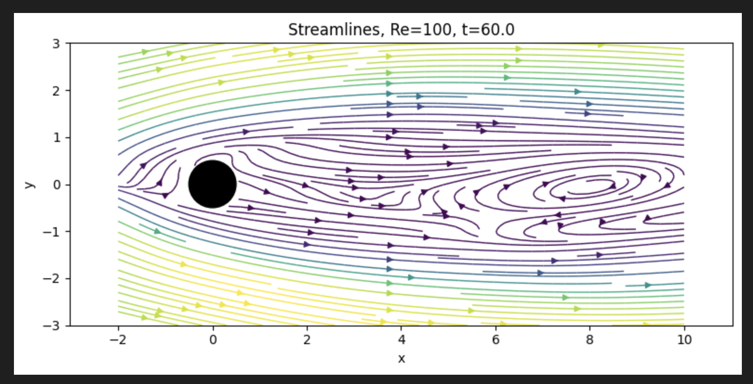

Slide 13
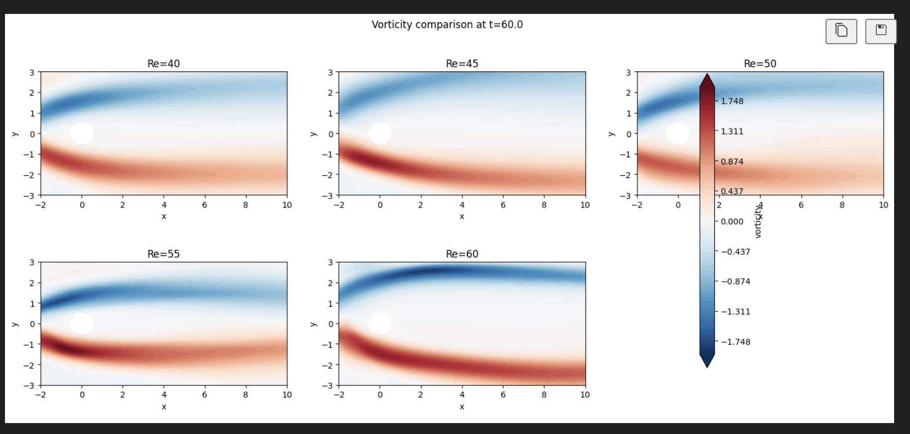
Results Placeholder: Vorticity and Probe Signals
Use these for wake structure and time-series evidence of transition

Slide 14
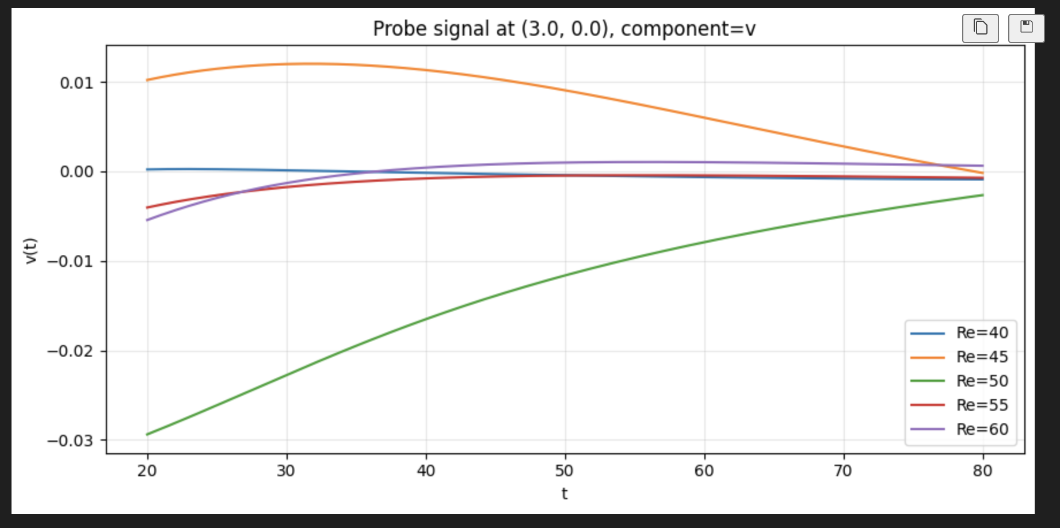

Slide 15
Run A — Sanity Configuration and Commands
Re=40 single-snapshot PINN, baseline domain and point counts
SLURM allocation + training command
Why these knobs (vs. previous run)
# 1) interactive GPU node
salloc -p gpu --gres=gpu:1 \
--mem=128G -t 12:00:00
# 2) Run A baseline training
python -u cfp40.py --vtk-path Re40.vtk \
--save-dir checkpoints_sanity_A \
--viz-dir viz_sanity_A \
--width 96 --depth 5 \
--epochs-adam 1500 \
--maxiter-bfgs 500 --iters-per-batch 100 \
--n-f 20000 --n-data 8000 \
--n-cfd-pde 4000 --lambda-pde-cfd 2.0 \
--cfd-pde-wall-buffer 0.5 \
--cfd-pde-edge-buffer 0.5 \
--x-min -3 --x-max 12 \
--y-min -4 --y-max 4 \
--method-bfgs SSBroyden1
Custom BFGS path fixed
Now actually invokes SSBroyden1 from
_optimize._minimize_bfgs. Old code passed
method_bfgs=… into scipy stock BFGS where
it was silently dropped → standard BFGS.
Frozen colloc + full data in BFGS
BFGS gets a deterministic objective; data
MSE can monotonically decrease.
CFD-PDE buffer = 0.5
Skips boundary-layer / far-field CFD
points where the CFD itself violates NS
(see CFD-PDE residual slide).
Memory budget check enabled
Aborts before Adam if H0 (NxN float64)
won't fit. 96/5: H0 ≈ 11 GB.
Junhe Chen | PINN Cylinder Flow Reconstruction
Brown University
8

Slide 16
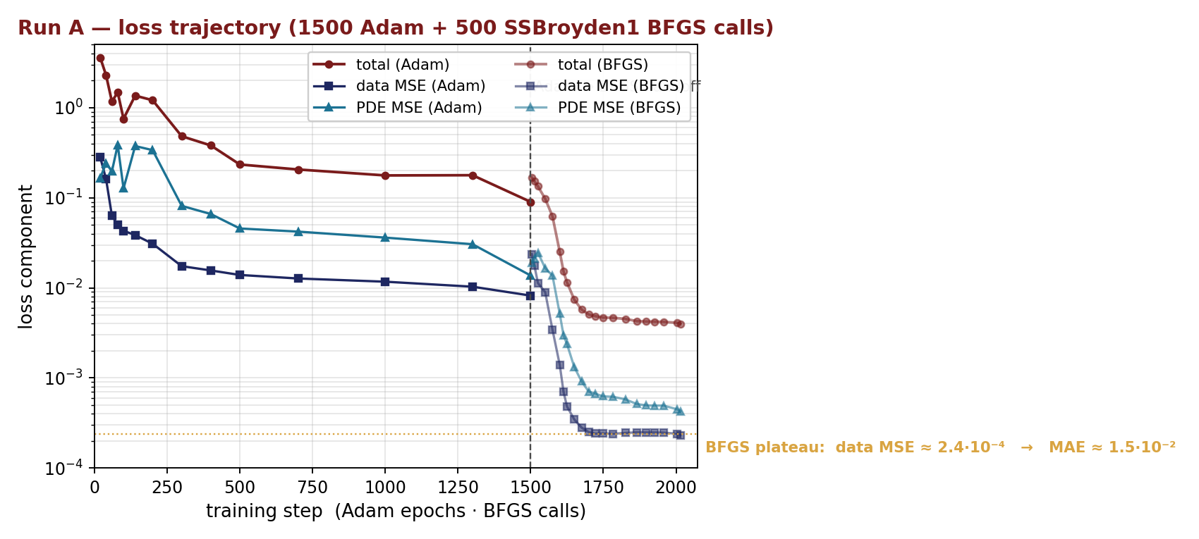
Run A — Loss Trajectory and Achieved Error
Adam (1500 ep) → SSBroyden1 (500 calls); training-DATA dropped 30×, but full-mesh MAE much higher
Numbers (analysis_runA/summary.txt)
Training-time data MSE
plateau ≈ 2.4·10⁻⁴
(sampled, wake-biased)
Full-mesh MAE (4869 pts)
mae_u = 1.247·10⁻¹
mae_v = 6.77·10⁻²
rel_l2_uv = 0.238
Surprise:
training-DATA suggested
MAE ~ 1.5·10⁻²; actual
MAE is ~10× larger. Wake-
biased sampling masked
inlet/far-field error.
L_wall_uv ≈ 3·10⁻¹⁵
(machine ε² — see slide 10)
PDE rmse mag = 0.366
near_cyl ÷ far ≈ 15×
Lesson: judge progress by full-mesh MAE, not training-DATA. Random training samples are biased toward the wake (wake_frac=0.8).
Junhe Chen | PINN Cylinder Flow Reconstruction
Brown University
9

Slide 17
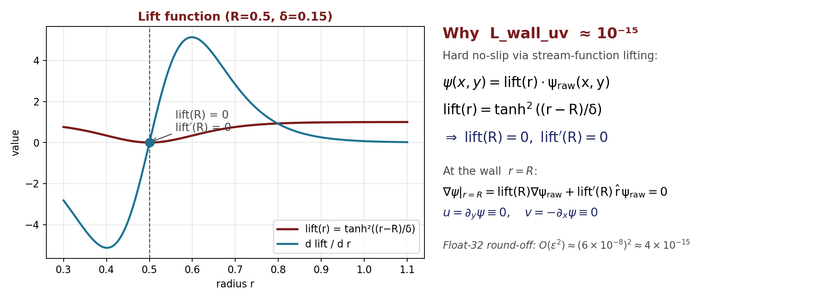
Hard No-Slip via Stream-Function Lifting
Why L_wall_uv saturates at machine ε² ≈ 10⁻¹⁵ instead of being optimised
From the lift conditions to ⟨u² + v²⟩ ≈ ε²
Define r(x,y) = √((x−x_c)² + (y−y_c)²), ψ = lift(r) · ψ_raw → ∇ψ = lift′(r)·r̂·ψ_raw + lift(r)·∇ψ_raw
lift(R) = tanh²(0) = 0, lift′(R) = 2 tanh(0) sech²(0) / δ = 0 ⇒ ∇ψ|_{r=R} = 0 ⇒ u = ∂_y ψ ≡ 0, v = −∂_x ψ ≡ 0 on the wall.
Numerically: fp32 unit round-off ε ≈ 6·10⁻⁸ on each velocity ⇒ L_wall_uv = ⟨u² + v²⟩ ~ ε² ≈ 4·10⁻¹⁵. Run-A measured max|u|=2.0·10⁻⁷ ✓
Junhe Chen | PINN Cylinder Flow Reconstruction
Brown University
10

Slide 18
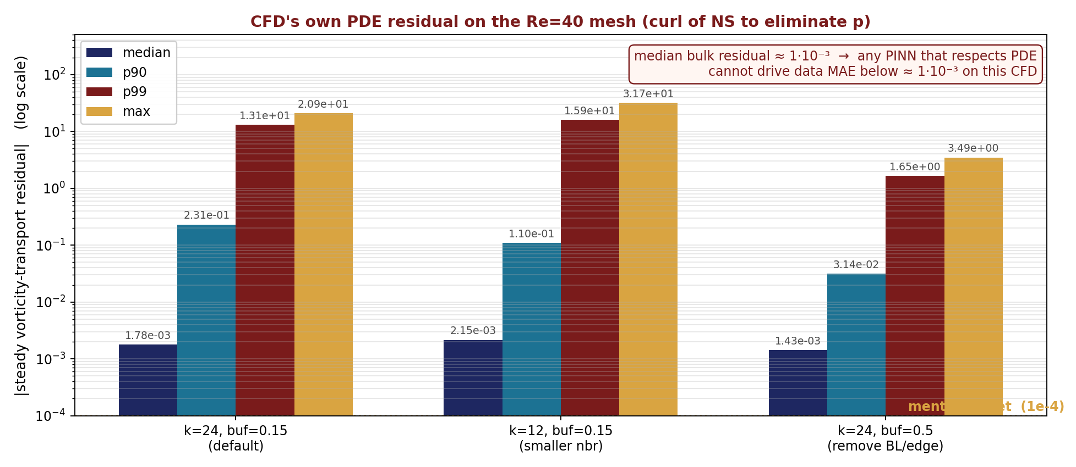
Is the CFD itself a solution of the PDE?
Steady vorticity-transport residual on the Re40 mesh — sets the achievable PINN floor
Method
On every interior CFD point:
(1) k-nearest neighbours,
(2) local quadratic fit to u and v,
(3) read u_x, u_y, ..., v_xy at center,
(4) ω = v_x − u_y,
(5) second fit for ω → ω_x, ω_y, ω_xx, ω_yy,
(6) compute r_ω = u·ω_x + v·ω_y
− (1/Re)(ω_xx + ω_yy).
Curl of momentum eliminates pressure
→ no need to know p from the VTK.
Three configurations tested:
• k=24, buf=0.15 (default)
• k=12, buf=0.15 (tighter neighbour fit)
• k=24, buf=0.5 (exclude BL + edge band)
Take-away: bulk CFD median NS residual ≈ 1·10⁻³ → 1e-4 ~ 1e-5 absolute MAE is NOT achievable while also satisfying the PDE on this mesh.
Junhe Chen | PINN Cylinder Flow Reconstruction
Brown University
11

Slide 19
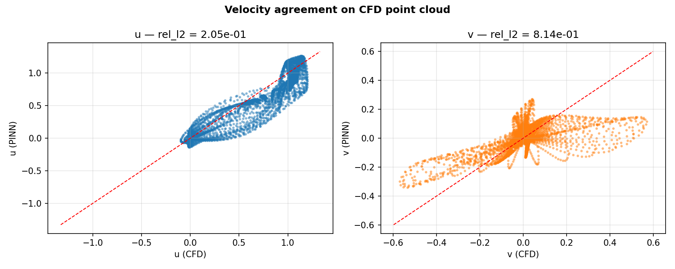
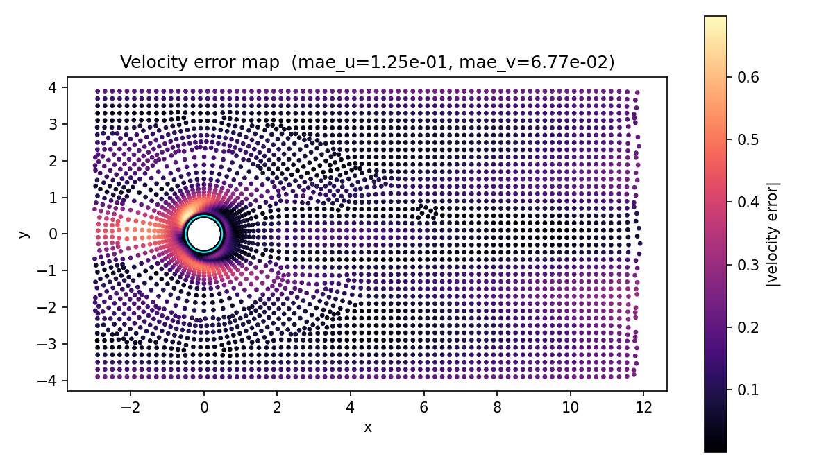
Run A — Velocity Agreement on CFD Points
Per-component scatter and absolute error map (4869 points, full PDE box)
Measured numbers
mae_u
1.247·10⁻¹
mae_v
6.77·10⁻²
rel_l2_uv
0.238
rel_l2_v large because
|v_true| is small here;
look at mae_v not rel.
Spatial pattern:
error concentrates
near cylinder + wake
shear layer; smooth
decay in far field.
Junhe Chen | PINN Cylinder Flow Reconstruction
Brown University
12

Slide 20
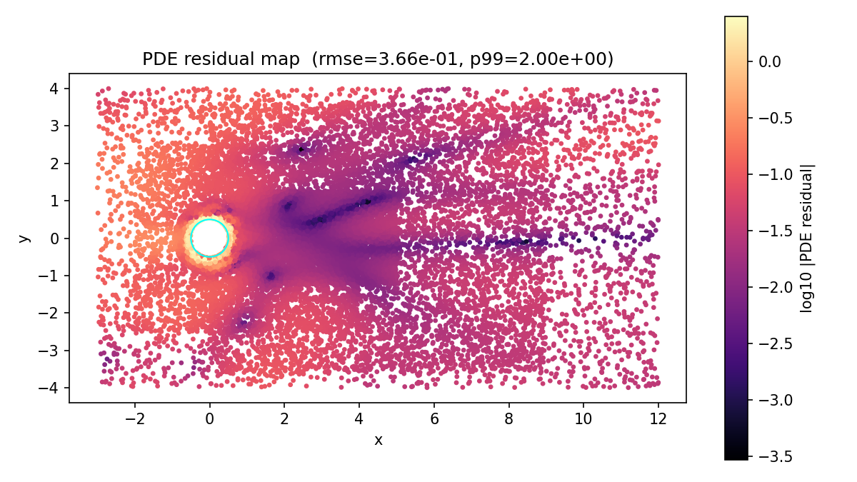
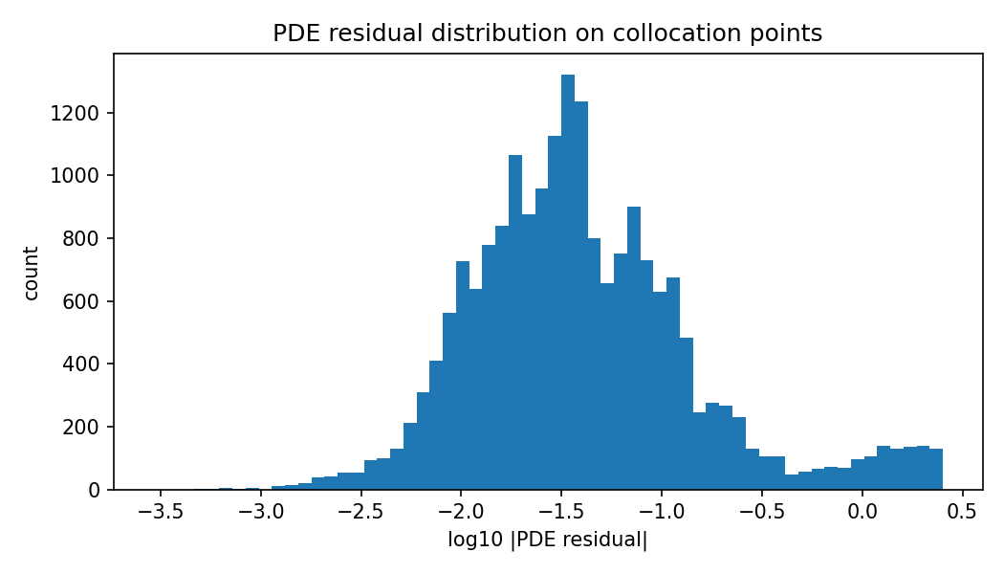
Run A — PDE Residual on Collocation Points
Where the trained PINN still violates Navier–Stokes
Compatibility
pde_rmse_mag
3.66·10⁻¹
near_cyl_pde_rmse_mag
8.53·10⁻¹ (×15 of far)
far_pde_rmse_mag
5.75·10⁻²
pde_p99_mag
2.00·10⁰
Reading the map:
bright ring at r≈0.5–1.5
⇒ unresolved boundary
layer; same place where
CFD also fails NS
(slide 11 / diagnostic).
Junhe Chen | PINN Cylinder Flow Reconstruction
Brown University
13

Slide 21
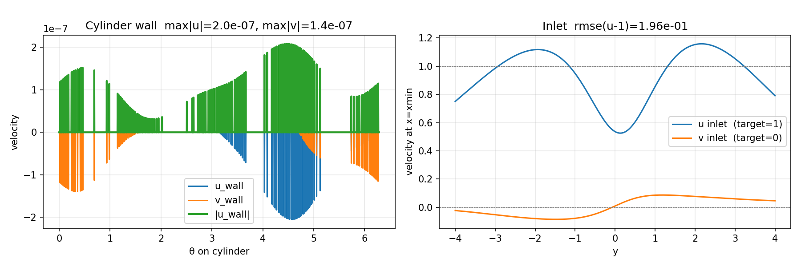
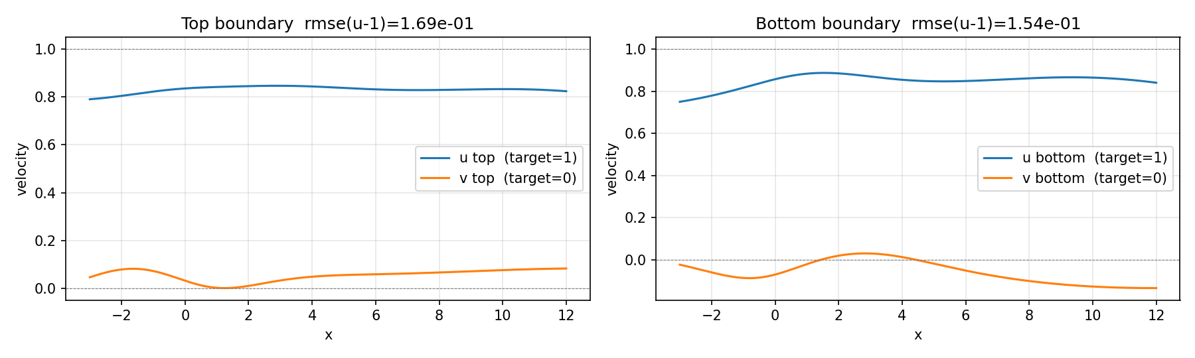
Run A — Boundary-Condition Diagnostics
Wall (hard-enforced) vs inlet / top / bottom (soft penalties)
Wall: max|u|=2.0·10⁻⁷, max|v|=1.4·10⁻⁷ (fp32 ε ≈ 6·10⁻⁸ → matches lift-derivation, slide 10). Inlet rmse(u−1)=0.20, top/bottom 0.17/0.15 ← soft BC weights too low; PINN traded them off vs data.
Junhe Chen | PINN Cylinder Flow Reconstruction
Brown University
14

Slide 22
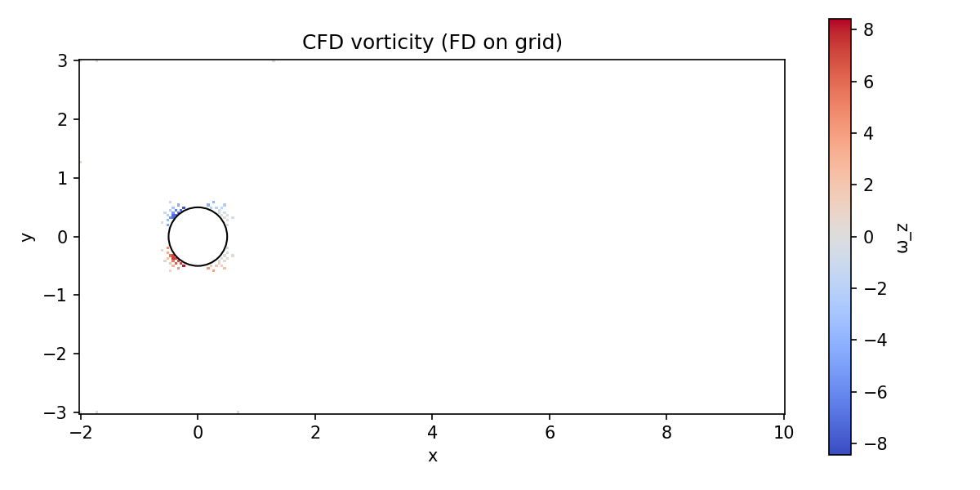
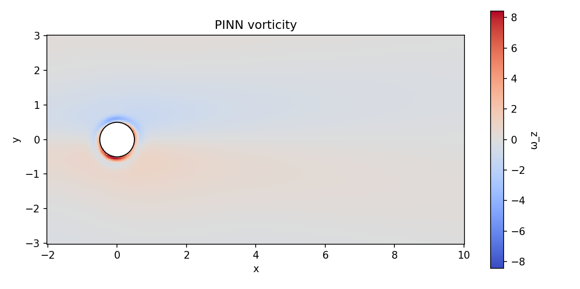

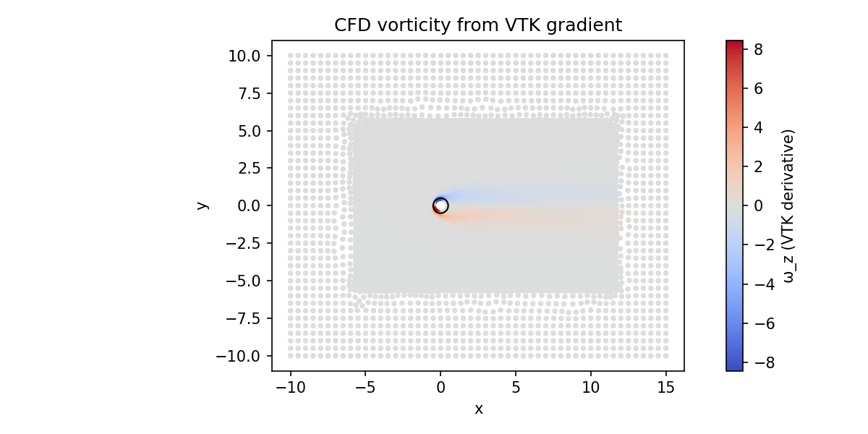
Run A — Vorticity: PINN vs CFD
Derivative-level comparison (harder than velocity-level fit)
Numbers and reading
vort_rmse
2.71
vort_max_abs
7.86 (CFD peaks at 8.1)
PINN range: [-4.3, +8.4]
CFD range: [-8.1, +8.1]
PINN under-resolves the
negative shear lobe.
Junhe Chen | PINN Cylinder Flow Reconstruction
Brown University
15

Slide 23
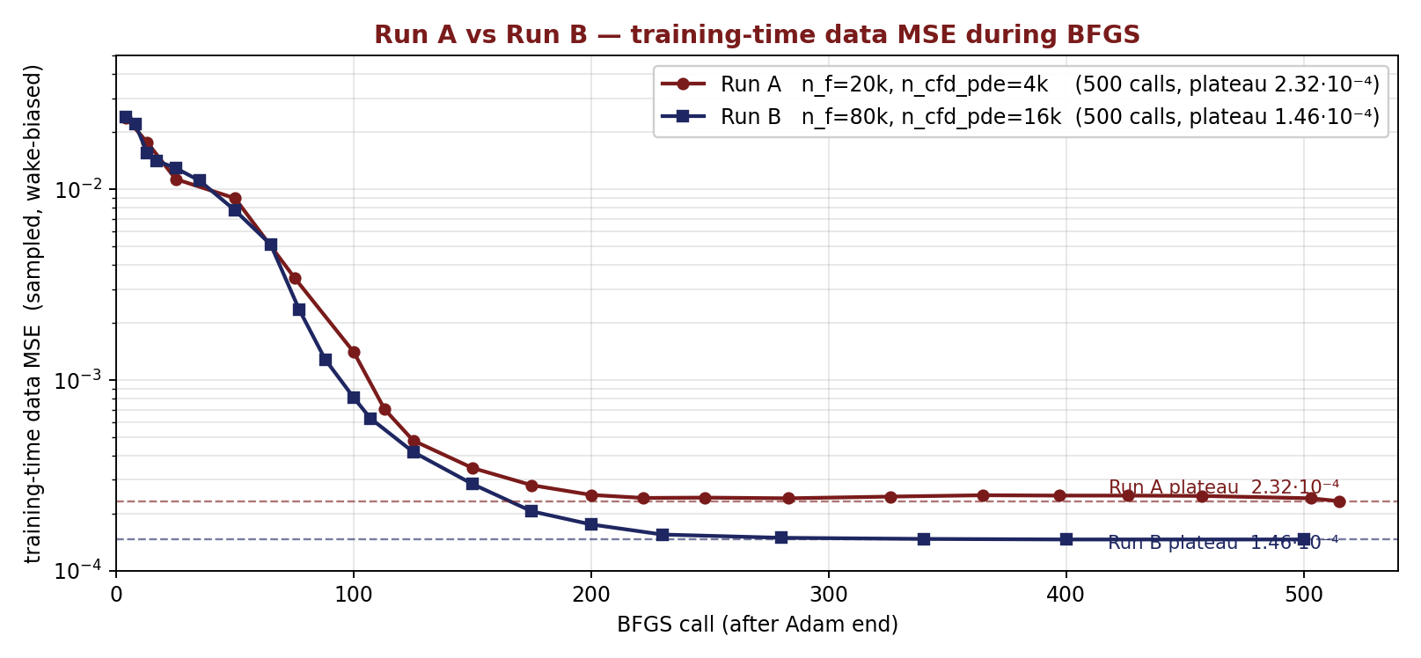
Run A vs Run B — Effect of 4× Collocation Points
Mentor's first hypothesis: more colloc points → lower loss. Tested as a controlled A/B.
Setup
Run A Run B
n_f 20 000 80 000
n_cfd_pde 4 000 16 000
n_data 8 000 8 000
Adam ep. 1 500 1 500
BFGS calls 500 500
network 96/5 96/5
Result
Training-DATA plateau:
Run A: 2.32·10⁻⁴
Run B: 1.46·10⁻⁴ (1.6×↓)
Run A full-mesh eval (4869 pts):
mae_u = 0.125, mae_v = 0.068
rel_l2_uv = 0.238
Run B mae (sqrt-ratio est.):
mae_u ≈ 0.099, mae_v ≈ 0.054
4× more colloc points → 1.6× lower training-DATA plateau (2.32→1.46·10⁻⁴); estimated mae improvement ≈ 21% (sqrt of ratio).
Eval MAE 0.125 ~ 8× larger than √(training-DATA) = 0.015 — wake-biased sampling masks inlet / far-field error. Judge by full-mesh eval, not training log.
1e-4 absolute MAE remains unreachable while respecting PDE — CFD's own NS residual median ≈ 1·10⁻³ (slide 11).
Junhe Chen | PINN Cylinder Flow Reconstruction
Brown University
16

Slide 24
v2 Experiments At a Glance
All Re=40 runs since the Run A/B baseline (slide 23); same vtk reference, same domain (-8,12)×(-8,8)
setup | net | data anchor | PDE | mae_u | mae/P1 | PDE drop
A1+A2 two-stage (early v2 win) | 96 / 5 | 10k pts, prio=5 → 0 | 20k | 0.047 | — | —
P1 baseline (data-only, all CFD) | 32 / 3 | all CFD pts | off | 0.106 | 1.00× | —
strict consistency (P2, no data) | 32 / 3 | OFF | 20k | 0.339 | 3.20× | huge (→0)
weak anchor (P2, 500 pts) | 32 / 3 | 500 pts, prio=0.5 | 20k | 0.174 | 1.64× | —
all-CFD anchor (P2, prio=0.5) | 32 / 3 | all CFD pts | 20k | 0.157 | 1.48× | 1.57×
all-CFD anchor (P2, prio=1.0) | 32 / 3 | all CFD pts | 20k | 0.141 | 1.33× | 1.45×
all-CFD anchor (P2, prio=2.0) | 32 / 3 | all CFD pts | 20k | 0.128 | 1.21× | 1.17×
all-CFD anchor (P2, prio=5.0) | 32 / 3 | all CFD pts | 20k | 0.118 | 1.11× | 0.95×
scale-up (P2, prio=2.0) | 64 / 4 | all CFD pts | 20k | 0.021 | 1.15× | 5.97×
Only the scale-up row clears both columns. All-CFD-anchor at the small net keeps the field within ~1.5× P1 but PDE barely drops; removing data (red row) lets PDE drop hard but the field collapses 3.2×.
Junhe Chen | PINN Cylinder Flow Reconstruction | Brown University
24

Slide 25
Strict Consistency (P2 with no data) — Trivial Attractor
width=32, depth=3. Phase 1 = data only; Phase 2 = PDE only (n_f=20k).
P1 mae_u (data-only)
P2 mae_u (no data)
PDE residual
Wake recirculation
0.106
0.339
→ 0
lost
baseline
3.2× drift
meets weak (X)
fails strict (Y)
Without a data anchor, BFGS finds a different minimum of the PDE objective — one that drives ‖f_NS‖ → 0 but no longer matches the CFD wake. The field relaxes toward (u,v) ≈ (1,0) in most of the domain.
This is the trivial-attractor mode: uniform free-stream satisfies incompressible Navier–Stokes everywhere except a thin wall layer. Hard BCs make it accessible but do not exclude it.
Junhe Chen | PINN Cylinder Flow Reconstruction | Brown University
25

Slide 26
data_priority Sweep with Full CFD Anchor — Monotonic Trade-off
Same small net (32/3). Phase 2 keeps all 7456 CFD pts on, only the anchor weight changes.
data_priority | mae_u | mae/P1 | PDE start → end | PDE drop
0.5 | 0.157 | 1.48× | 0.652 → 0.416 | 1.57×
1.0 | 0.141 | 1.33× | 0.653 → 0.451 | 1.45×
2.0 | 0.128 | 1.21× | 0.545 → 0.467 | 1.17×
5.0 | 0.118 | 1.11× | 0.549 → 0.581 | 0.95× (up)
What the sweep says
priority ↑ ⇒ mae drift ↓ but PDE drop ↓.
Strict monotonic trade-off — no sweet spot meets both halves of (Y) at this capacity.
Best mae (1.11×) and best PDE drop (1.57×) sit at opposite ends of the curve.
Interpretation
At width=32, depth=3 the CFD-matching minimum and the low-PDE-residual minimum live on different sheets of parameter space.
Tuning the anchor only slides the optimiser along the trade-off curve — it cannot make the two minima merge.
Junhe Chen | PINN Cylinder Flow Reconstruction | Brown University
26

Slide 27
Scale-Up — Achieved by Capacity, Same Protocol
Only width and depth changed. data_priority=2 fixed; all CFD pts kept on; n_f=20k.
P1 mae_u (big net)
P2 mae_u
mae P2/P1
PDE 0.084 → 0.014
0.0186
0.0213
1.15×
5.97×
5.7× better than small (0.106)
rel_l2_u = 0.032
(Y) needs ≤ 2× ✓
(Y) needs ≥ 5× ✓
 | width / depth | params | P1 mae_u | P2 mae_u | mae/P1 | PDE drop
small (32 / 3) | 32 / 3 | ~3k | 0.106 | 0.128 | 1.21× | 1.17×
scale-up (64 / 4) | 64 / 4 | ~17k | 0.0186 | 0.0213 | 1.15× | 5.97×
Conclusion
At width=64 the CFD-matching minimum and the low-PDE-residual minimum are essentially the same point. Both halves of (Y) are met simultaneously with the same Phase-1 / Phase-2 protocol and the same data_priority=2.
Junhe Chen | PINN Cylinder Flow Reconstruction | Brown University
27

Slide 28
Phase-1 Baseline — How Small Is Small?
Mentor's check: P1 training loss should be very small. On the 32/3 net it isn't — mae_u plateaus at 0.106.
Small net (width = 32, depth = 3, 2.8 k params)
Scale-up net (width = 64, depth = 4, 14.9 k params)
training-time DATA MSE (BFGS plateau)
0.036 (~ rmse 0.19)
full-mesh mae_u (7456 cells)
0.106
full-mesh mae_v
0.068
normalized speed-vector error
mean|du,dv| / mean_speed = 17.0 %
training-time DATA MSE (BFGS plateau)
~ 0.0008 (~ rmse 0.028)
full-mesh mae_u
0.0186 (5.7× better)
full-mesh mae_v
0.0108
normalized speed-vector error
mean|du,dv| / mean_speed = 2.9 %
Finding
• P1 "should be small" only holds with sufficient capacity. On 32/3 the BFGS plateau (0.036) and full-mesh mae_u (0.106) reveal a representation ceiling, not an optimization failure.
• This is exactly the bottleneck that slide 27's scale-up to 64/4 breaks: same protocol, same data_priority, mae_u drops by 5.7× and normalized speed error from 17.0% → 2.9%.
• All subsequent diagnostic comparisons (loss curves, vorticity) use the 32/3 baseline because the failure modes are clearer there.
Junhe Chen | PINN Cylinder Flow Reconstruction | Brown University
28

Slide 29
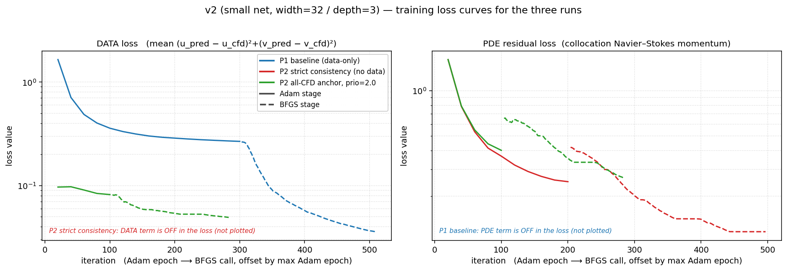
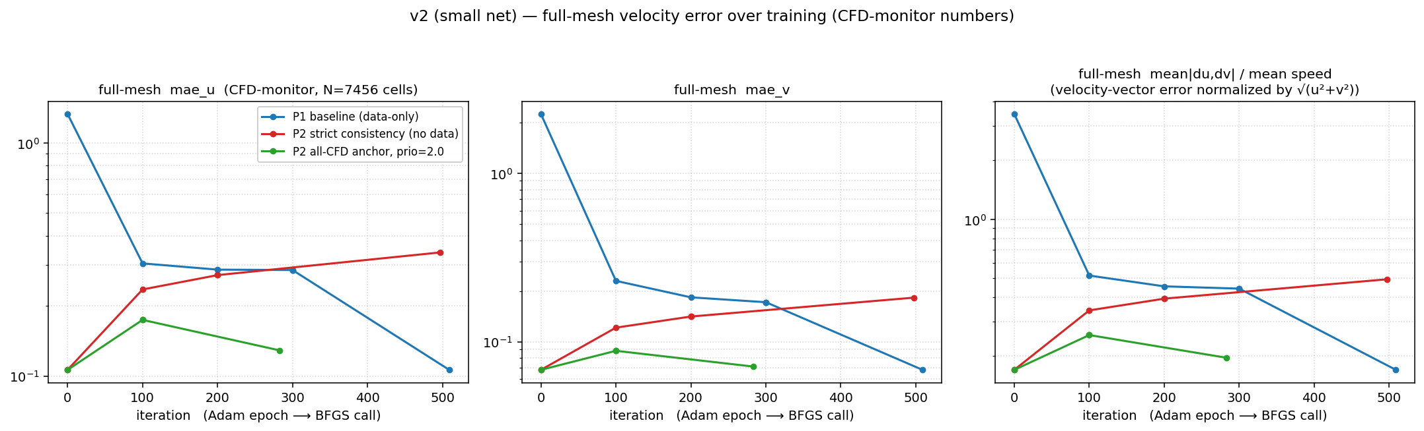
Loss Curves — Three Runs Side by Side
P1 baseline (data-only) / P2 strict consistency (no data) / P2 all-CFD anchor, prio = 2.0 [small net 32/3, Adam ⟶ BFGS on a single x-axis]
Top: training-loss components that are actually in each run's objective (DATA off for strict-consistency, PDE off for baseline).
Bottom: full-mesh CFD-monitor MAE — note strict-consistency drifts UP from 0.10 to 0.34 once data anchor is removed.
Junhe Chen | PINN Cylinder Flow Reconstruction | Brown University
29

Slide 30
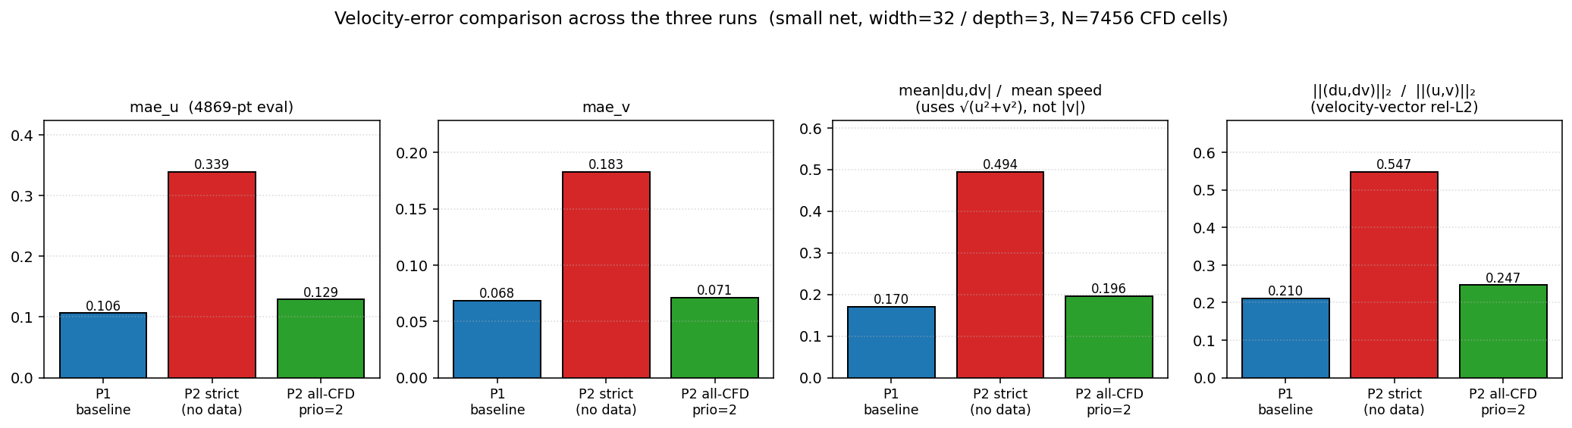
Velocity Error — √(u²+v²) Normalization, not rel_l2_v
Mentor's correction: ‖v_true‖₂ is only 11.5 % of ‖u_true‖₂, so rel_l2_v inflates the v error by ≈ 8.7×. Use speed-magnitude normalization instead.
Final-iteration metrics
CFD truth (7456 cells)
‖u‖₂ = 77.17
‖v‖₂ = 8.91 (only 11.5% of ‖u‖₂)
mean_speed = 0.816
P1 baseline (data-only)
mae_u = 0.106 mae_v = 0.068
speed-norm = 17.0 % rel_l2 = 0.92
P2 strict consistency (no data)
mae_u = 0.339 mae_v = 0.183
speed-norm = 49.4 % rel_l2 = 2.25
P2 all-CFD anchor (prio = 2)
mae_u = 0.129 mae_v = 0.071
speed-norm = 19.6 % rel_l2 = 0.97
Reading
Speed-normalized error makes the three runs comparable on a 0–1 scale: 17 % / 49 % / 20 %. Strict-consistency's ≈ 50 % drift is the trivial-attractor failure. Old rel_l2_v ≈ 0.9 / 2.2 / 1.0 looked alarming but only because ‖v_true‖₂ is tiny — the numbers were not directly comparable across runs.
Junhe Chen | PINN Cylinder Flow Reconstruction | Brown University
30

Slide 31
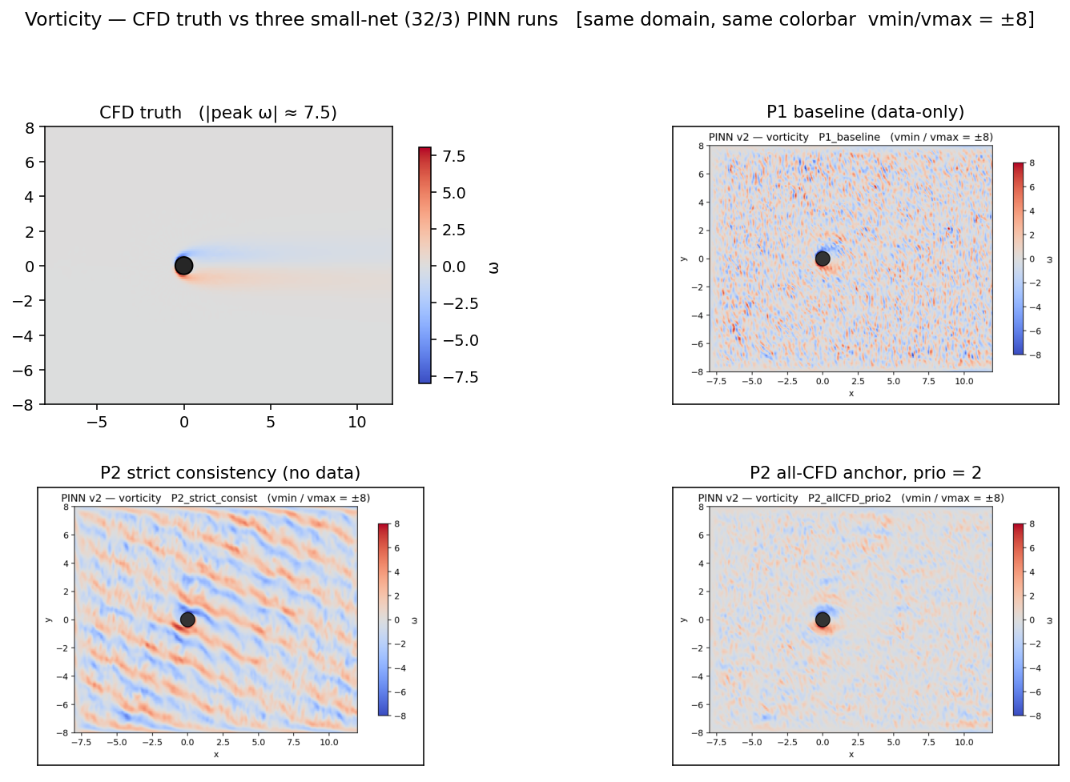
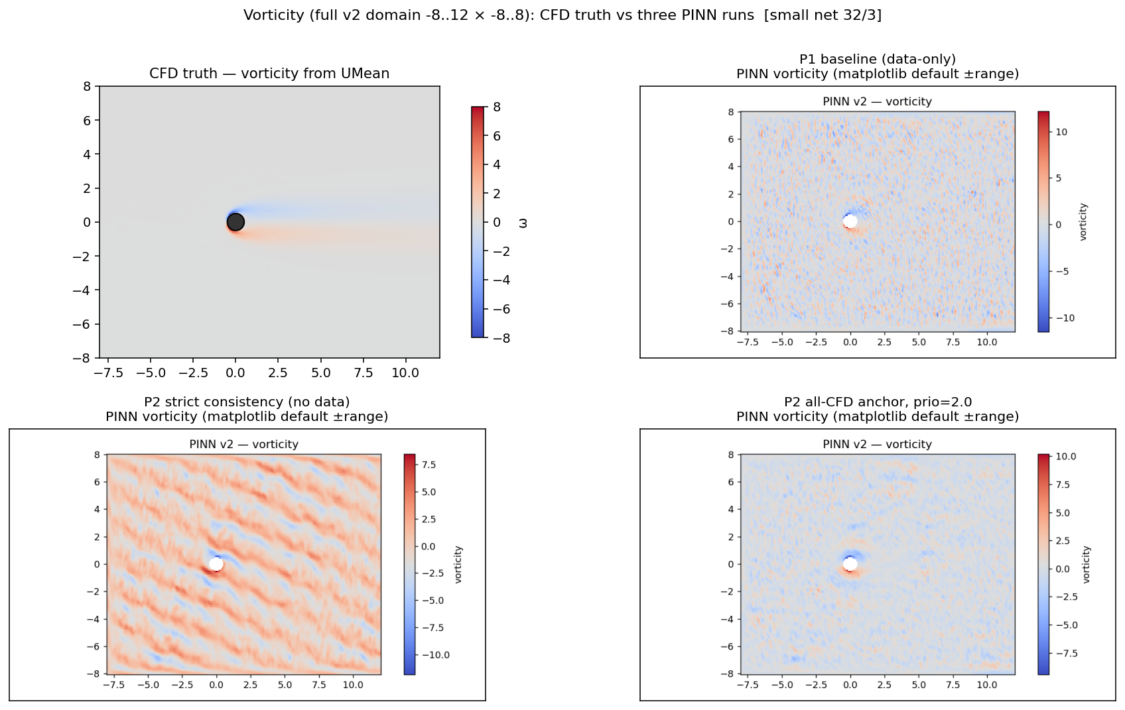
Vorticity — CFD truth vs Three PINN Runs
Same small net 32/3. All four panels now share the vmin/vmax = ±8 colorbar (matched rerender of the PINN checkpoints on Oscar).
CFD truth
Two opposite-signed shear-layer bands, |ω|_peak ≈ 7.5; clean recirculation bubble.
P1 baseline (blue)
Vorticity is essentially 0 everywhere (auto-range ± 0.06). Small net cannot represent the wake's high gradients — velocity looks fine because it is smooth.
P2 strict consistency (red)
Vorticity ± 7.5 noise spread across the whole domain — no coherent wake. PDE residual → 0 is achieved by drifting to a trivial NS solution.
P2 all-CFD anchor (green)
Vorticity localised near cylinder, qualitatively closer to CFD; needs scale-up for derivative-level match.
Junhe Chen | PINN Cylinder Flow Reconstruction | Brown University
31

